Slide 1

VINCENT OBIGWE
CHARLES OKERE
ASADUJAMAN NUR
SPIDERBOT
ABEEB NURENI
MARWA HASSAN
MIGUEL RODRIGUEZ

Slide 2














Slide 3

SYSTEM ENGINEERING

Slide 4




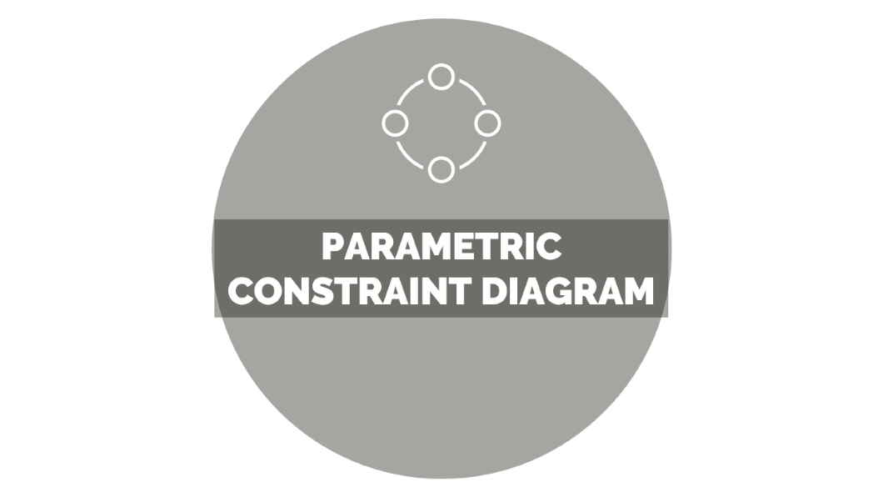
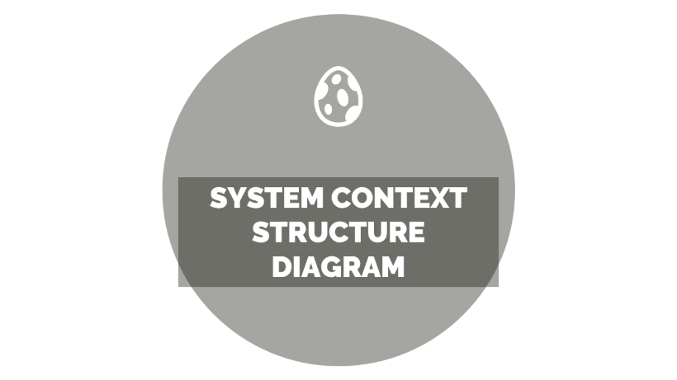



SYSTEM ENGINEERING

Slide 5

PARAMETRIC CONSTRAINT DIAGRAM

Slide 6



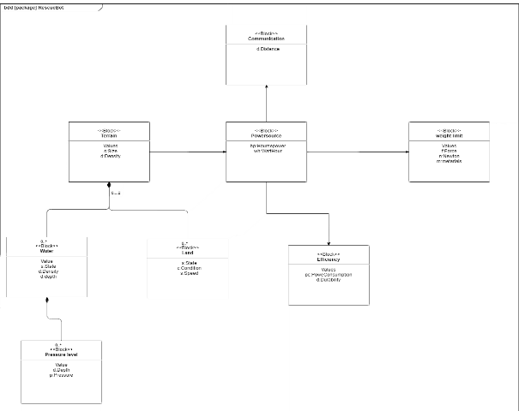
CONSTRAINT DIAGRAM
This helps to highlight the various constraints that the system developers would need to consider.

Slide 7

SYSTEM CONTEXT STRUCTURE DIAGRAM

Slide 8


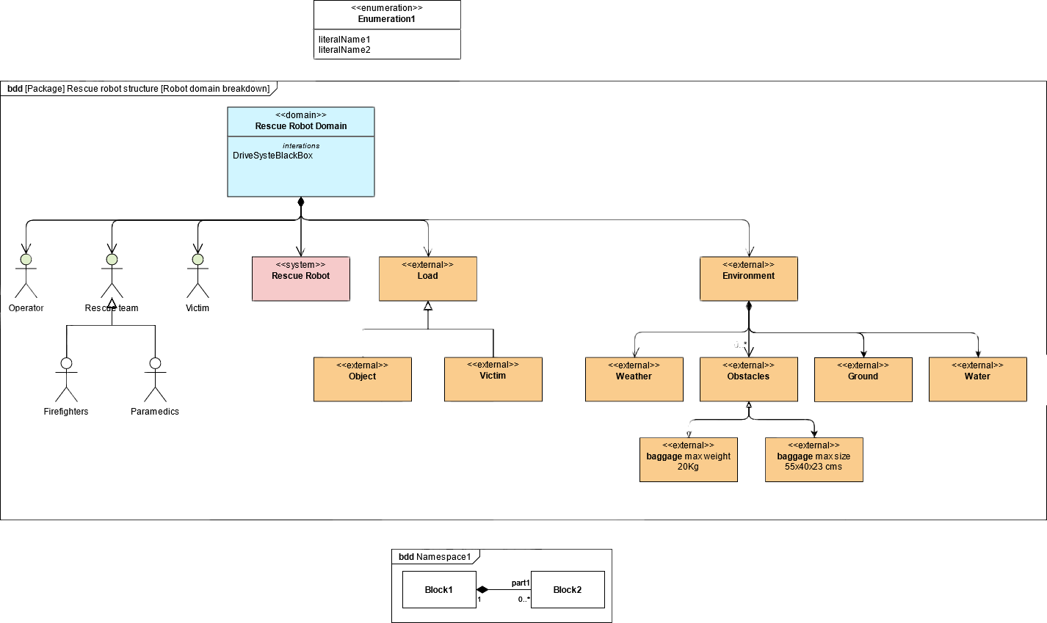
CONTEXT STRUCTURE
This explains the various actors in the system, both internal and external.

Slide 9

SYSTEM STRUCTURE DIAGRAM

Slide 10


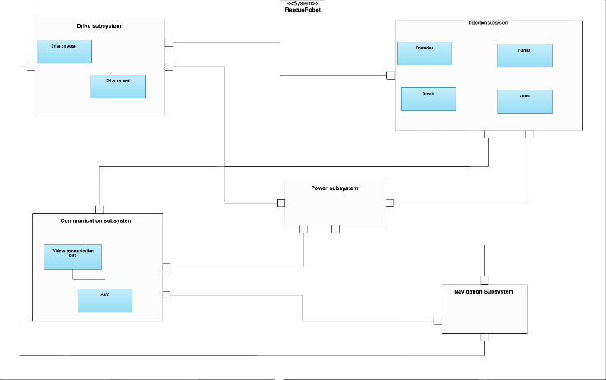
STRUCTURE DIAGRAM
This explains the various components of a system and how they communicate together.

Slide 11

USECASE SPECIFICATIONS

Slide 12







USECASE SPECIFICATIONS

Slide 13

ACTIVITY DIAGRAM

Slide 14


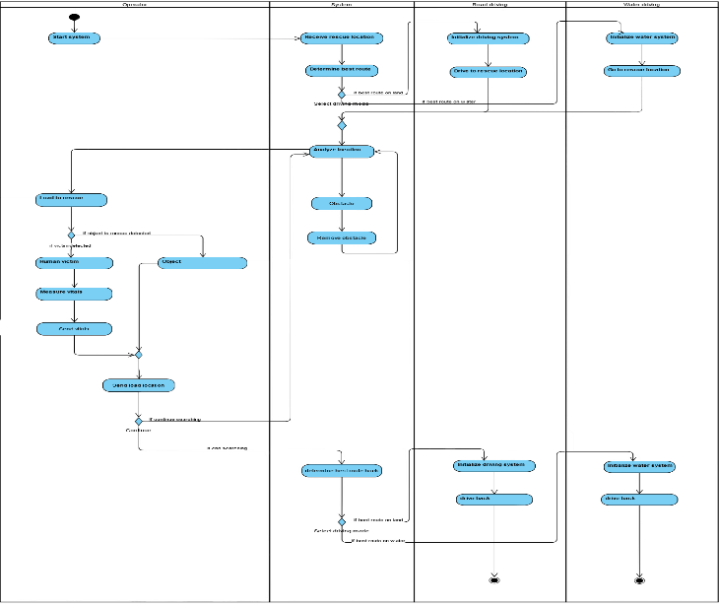
ACTIVITY DIAGRAM
Controls flow and object flows connects sequential and concurrent activities in the activity diagram

Slide 15

USECASE DIAGRAM

Slide 16


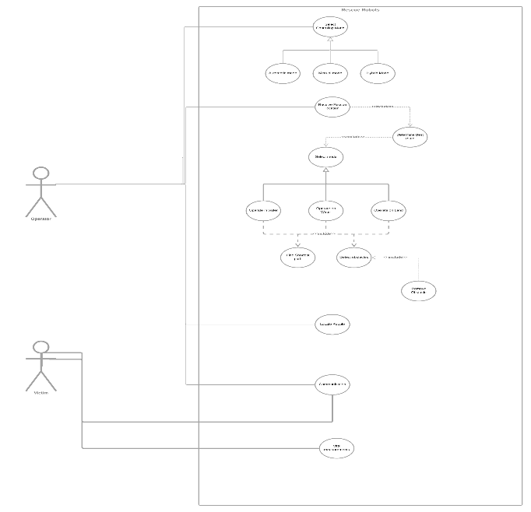
USECASE DIAGRAM
The robot rescuing system and the victim discovering systems are described in the use case

Slide 17

STATE MACHINE DIAGRAM

Slide 18


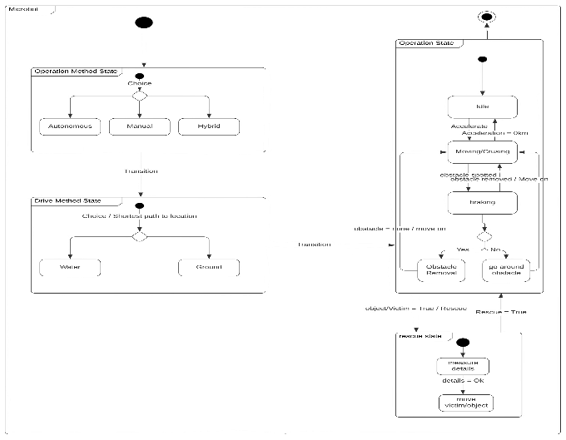
STATE MACHINE DIAGRAM
The State Machine Diagram shows us all the states that we can have in our Rescue robot system and the relations or the conditions to go from one state to another.

Slide 19

DESIGN

Slide 20




DESIGN

Slide 21
CONCEPT

Slide 22


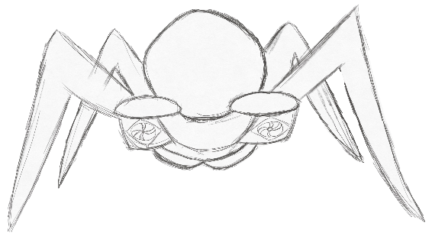
CONCEPT

Slide 23
PROTOTYPE

Slide 24


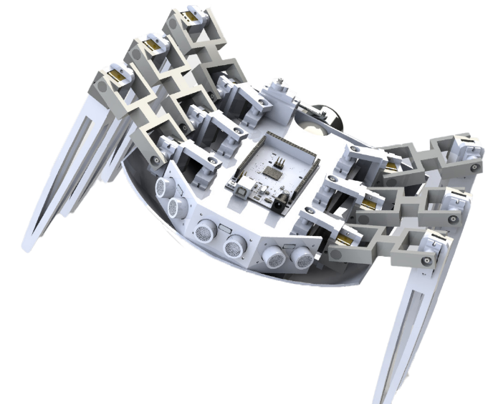
PROTOTYPE

Slide 25

ELECTRONIC SYSTEM

Slide 26
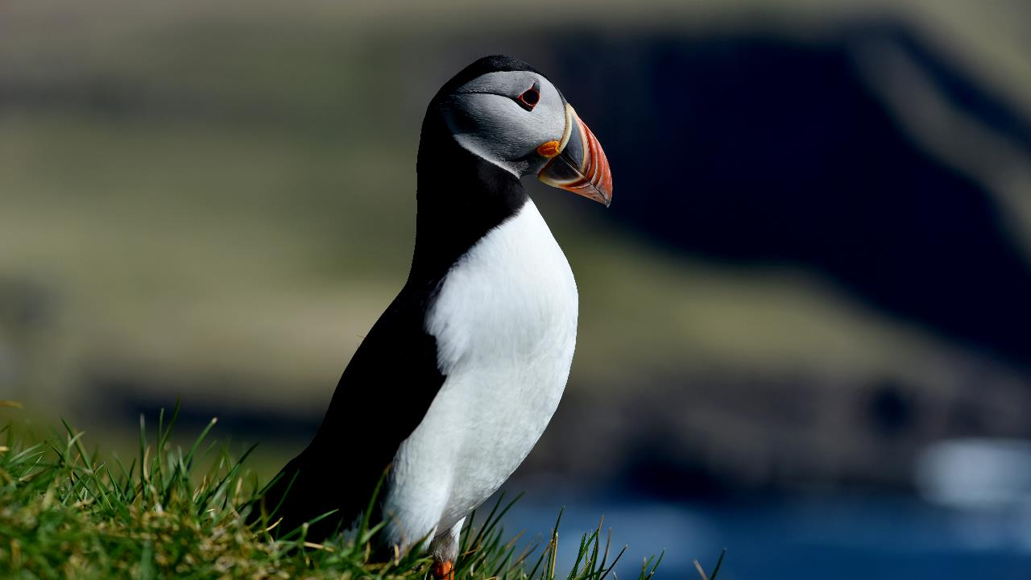





ELECTRONIC SYSTEM

Slide 27

ANATOMY

Slide 28


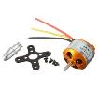
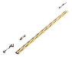

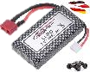
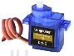

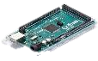
ANATOMY

Slide 29

CONTROLLER

Slide 30




CONTROLLER

Slide 31

COMPONENT LIST

Slide 32


COMPONENT LIST
S/N | ITEM DESCRIPTION | QUANTITIES | VOLTAGE & CURRENT RATING (V,A)
1 | ATmega2560 Microcontroller 52 channels | 1 | 7V-12V
2 | 7.4 V 1600 mAh Li-ion Power Battery | 2 | 7.4V, 1600mAh
3 | Multi temp mini hot glie stick | 1 | Nil
4 | SG90 Micro Servo motor- G9 | 19 | 4.8V, 100mA
5 | 120 pcs Breadboard jumper wires | 1 | Nill
6 | Pcs HC-SR04 Ultrasonic Module Distance Sensor | 2 | 5V, 15mA
7 | Rustark 420 pcs[#7 5/8” to 2-1/1”] zinc plated | 2 Sheets | Nill
8 | Electrical Insulation Tape | 1 | Nill
9 | Turbine Motor | 1 | 7V 17.8A, 10950 rpm. 12A/60s
10 | Turbine Shaft | 1 | Nill
11 | Turbine Blade | 1 | Nil
 | Referenced Weights | 364,14
 | Consumables Weights | 221
 | Total Weight | 585,14

Slide 33

ALGORITHM

Slide 34





ALGORITHM

Slide 35
Part-1

Slide 36


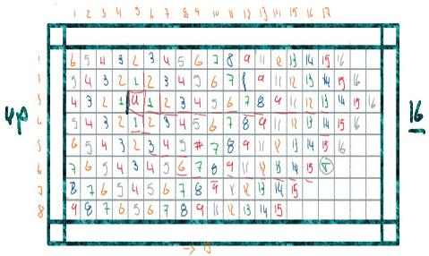
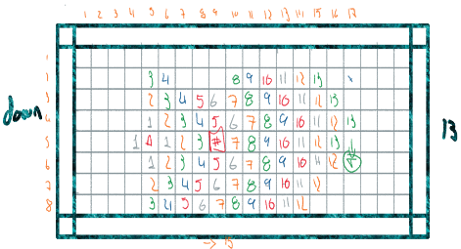
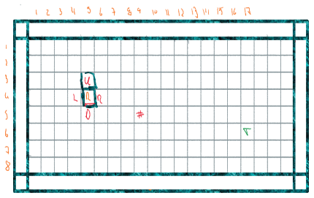
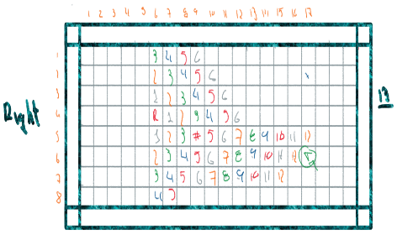
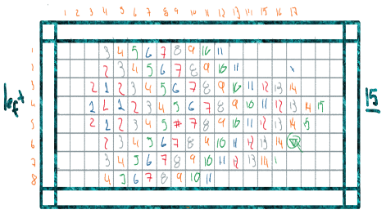
Part-1

Slide 37

Part-2

Slide 38


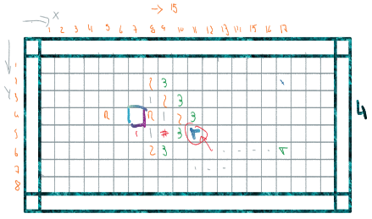
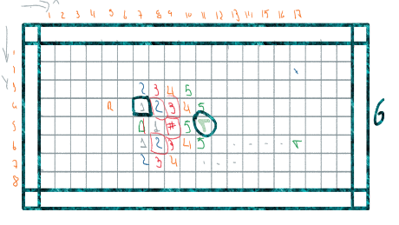
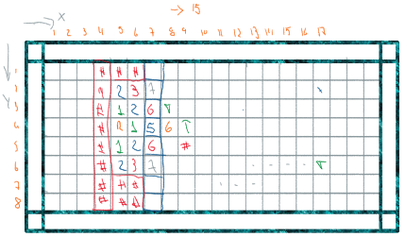
Part-2

Slide 39

PROGRAMMING &
SIMULATION

Slide 40






PROGRAMMING &
SIMULATION

Slide 41
CHALLANGE-1

Slide 42


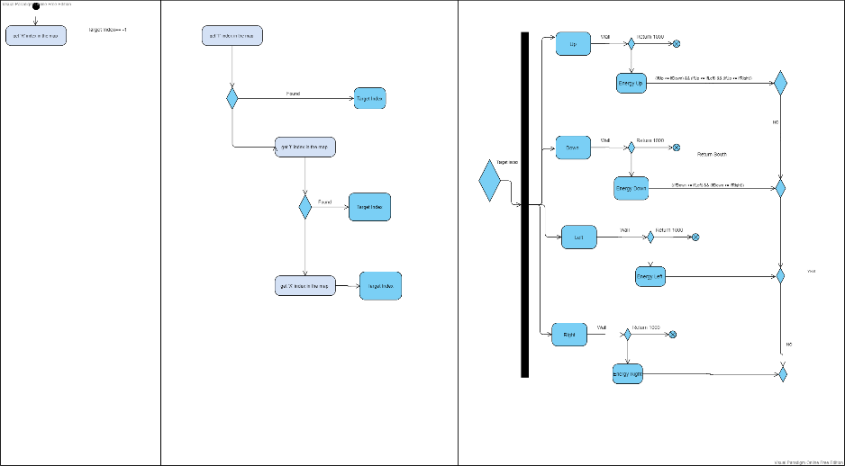
PART-1
Different Target
Wall

Slide 43

CHALLANGE-2

Slide 44


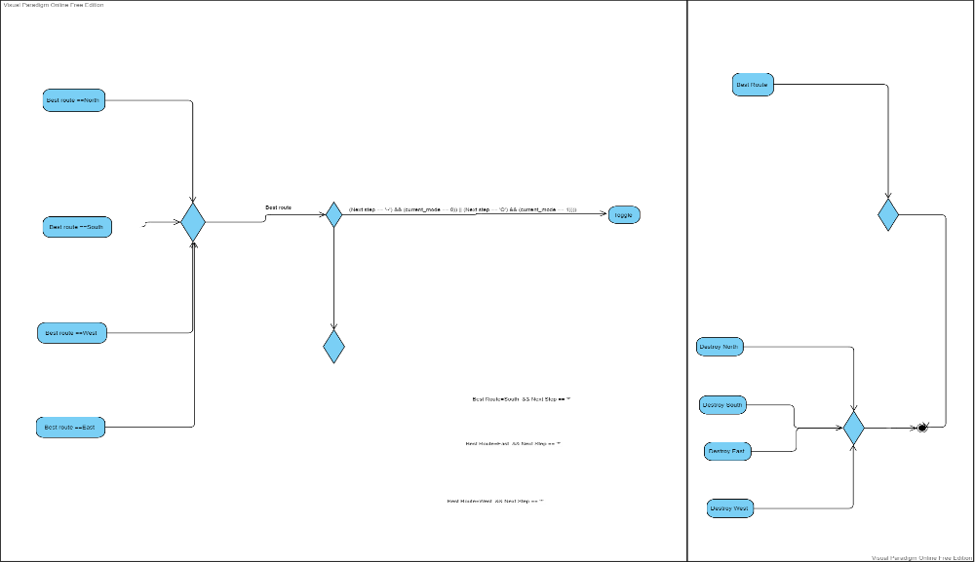
Part-2
Water
Obstacle
Best route
Best Route = North && Next step == ‘*’

Slide 45

Q & A

Slide 46
THANK FOR LISTENING
Q&A

